Slide 1
API & Cloud for data business
Promotion 2025-2026

Slide 2
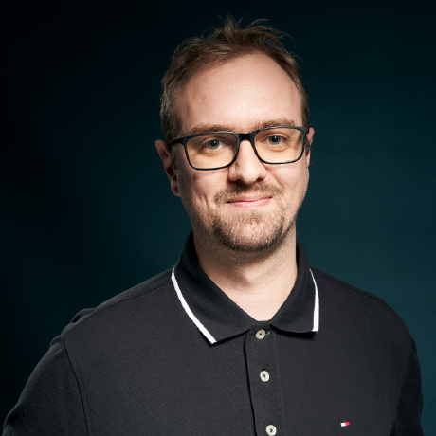

Présentations
Guillaume THOMAS
Staff ML Engineer
AXA France

Slide 3
Présentation du cours
API
Cloud
ML & MLOps
Pratiques d’ingénierie logicielle (git, python, dépendances, clean code, TU, CI/CD, sécurité, monitoring ect…)
Docker & Kubernetes
IA Générative
Agentic / MCP

Slide 4
Le cours
32h
8 x 4h
30min de pause (2 x 1h45 + 30min ou 3 x 1h10 + 2 x 15min)
Pensé comme un Hands-on plutôt qu’un cours magistral théorique

Slide 5
évaluation
1 note de C/C : réalisation d’un projet complet (50%) -> preuves de votre avancement par mail et commit git
1 note de QCM pendant les partiels (50%) -> documents papiers autorisés

Slide 6
Règles de vie
Pas de retard autorisé
Toute absence justifiée doit être rattrapée à la maison
Consultez vos camarades (votre délégué ?) pour obtenir les informations sur les attendus à rattraper
Maîtres mots : respect, entraide, bienveillance, écoute et calme
Vous êtes des professionnels, je vous considère comme tel

Slide 7
Derniers mots de présentation
L’intégralité de ce cours est libre d’utilisation
Les supports restent disponibles en ligne
Toutes les ressources utilisées sont gratuitement mises à disposition
Le cours est à jour malgré les profonds bouleversements du monde de l’IA de ces derniers mois
Il a été entièrement remanié POUR VOUS (pas pour moi)
Professeur n’est pas mon métier principal, le (très long) travail de préparation est fait sur mon (très mince) temps libre
Merci d’avance de votre résilience en cas de dysfonctionnements

Slide 8
Introduction au mlops

Slide 9
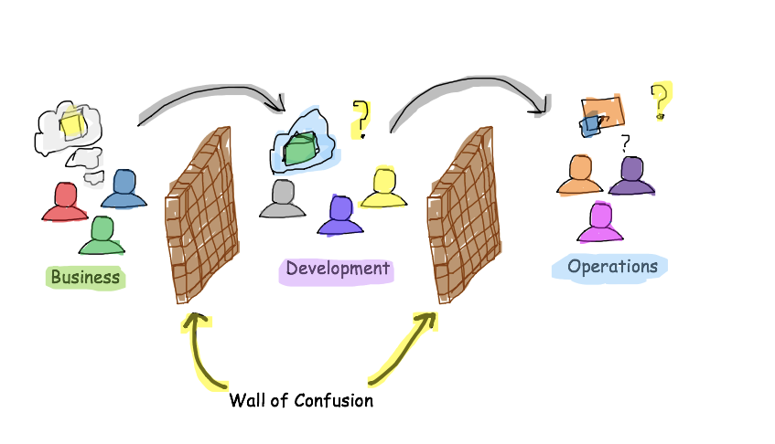
DEVOPS

Slide 10
Software Engineer
Data Scientist
Ops
Le MLOps est une aventure Humaine – Guillaume Chervet
Notes:
The first problem is a human problem, so today most applications require Developers and Operation engineers and it's already not easy to get everyone working together. On AI projects, we should also add a lot of expertise about data. We need Data experts.
Today, it’s almost impossible to be an expert in these 3 areas. Each party will have to trust one another and accept other party’s constraints.

Slide 11
Artificial Intelligence
Machine Learning
Deep Learning
Supervised
Le MLOps est une aventure Humaine – Guillaume Chervet
Notes:
One of the subsets of artificial intelligence is machine learning and one of the subsets of machine learning is deep learning.

Slide 12
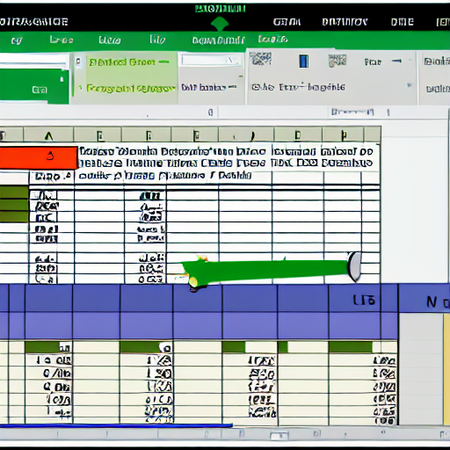
Structured data
"excel structured data"
Le MLOps est une aventure Humaine – Devoxx France 2023 – Guillaume Chervet
Notes:
You will often hear about structured data usually being represented by an Excel file. In general, for this kind of problem where there is a limited number of inputs/outputs. We will use simple machine learning algorithms.

Slide 13



"text from an old book on a table"
"camera outside on the beach"
"big music speaker"
Unstructured data
Le MLOps est une aventure Humaine – Guillaume Chervet
Notes:
When we have data like: sounds, images, videos. The number of possible inputs/outputs is generally higher. Consequently, we will generally use Deep learning algorithms which use neural networks.

Slide 14
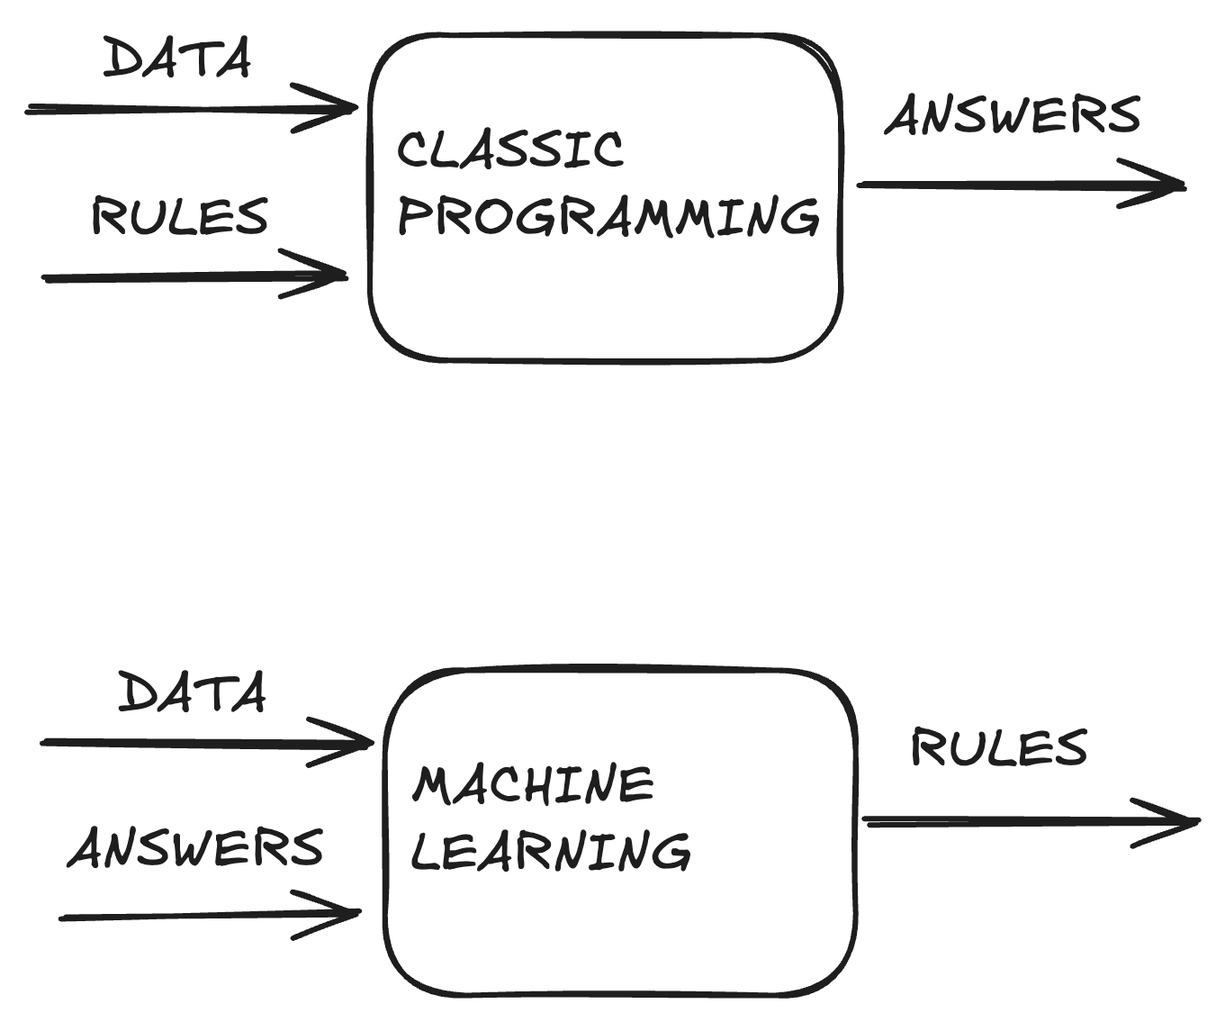
ML ?

Slide 15

La data

Slide 16

It’s alive

Slide 17
MLOps ?
Configuration
Data Collection
Data Verification
Machine Resource Management
Serving Infrastructure
Monitoring
ML Code
Analysis Tools
Feature Extraction
Process Management Tools
Source : Google, The Hidden Technical Debt In Machine Learning Systems

Slide 18
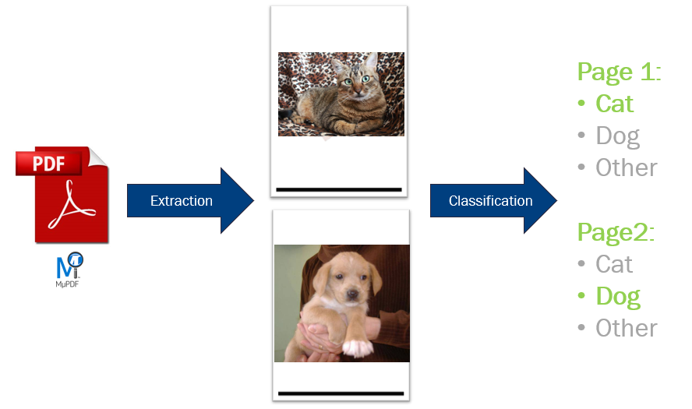
Le MLOps est une aventure Humaine – Guillaume Chervet

Slide 19

Dataset of 20 000 files
Train a model
13 000 train
4 000 validation
3 000 test
Le MLOps est une aventure Humaine – Guillaume Chervet
Notes:
Before starting the demo. Imagine that we have 20,000 files available. We will use 17,000 files for training the model. Then we will keep 3000 files aside for validation, to test our model on data it has never seen. This validation DATASET will also be used to test our production environments.

Slide 20

Data drift
"a race car drift deep on a road in a bend"
Le MLOps est une aventure Humaine – Guillaume Chervet
Notes:
Slide 20 After Demo Data drift
If we feed our models with different data. Data very different on which models have learned. Predictions may deteriorate.
For our email classification project, for example, if there is a change of layout for the accident report, it is possible that the AI ​​will fail to recognize automobile claims. In this case, it is necessary to retrain and then re-deploy model in production.
Let's takes a sample with our Demo. Now let's imagine that our users start using plush or inpainting cats and dogs, as you can see the predictions no longer work correctly.

Slide 21
Les enjeux en production
Answer users’ needs
Accurate AI predictions
Cheap
Fast
Secured
Monitored (data drift)
Fast retrain/deployment
Le MLOps est une aventure Humaine – Guillaume Chervet
Notes:
The most important thing in a project is to meet user’s needs.
User wants a good prediction quality,
User wants the cheapest project as possible,
User doesn’t want to wait for a result. At AXA France we must answer a prediction in less than 10 seconds for our use-cases.
Safety is non-negotiable.
We want the projects to be monitored. The idea is that if DATA DRIFT starts, this risk causing a production incident. If we are on a major project that can block AXA France, we are not going to wait for the incident to come.
So, the last point, we must be able to re-train and redeploy quickly. If we have a major incident that blocks AXA France, we must be able to re-deploy as quickly as possible and not wait months to unblock the situation.

Slide 22
Quicker response
Better prediction
Cheaper
Le MLOps est une aventure Humaine – Guillaume Chervet
Notes:
First, there is an iron triangle of choice. A cursor to position between the prediction quality, the response time and the cost of the infrastructure in production.
If we want to have the best quality of prediction, we can agree to pay more or lose some response time.
But, if you want to be able to respond more quickly, you must be able to accept either to pay more or to lose prediction quality.
Finally, if we want the project to cost less in production, we must either agree to extend the response processing time or reduce the quality of prediction.

Slide 23
Recipes to fail
Exploration
Industrialization
Deployment & run
Project timeline
Le MLOps est une aventure Humaine – Guillaume Chervet
Notes:
To start, we will organize our team. In an AI project, there are 3 main phases. The first phase is the exploration phase, we will test if the project is feasible, then we move on to an industrialization phase and finally we have a “Deployment and Run” phase.
So here, I present to you Elisabeth, Elisabeth is a Data Scientist. We asked her to work alone on the exploration phase.

Slide 24

Recipes to fail
Exploration
"Data scientist girl who cook with a suit in a kitchen, artstation concept art"
Project timeline
Le MLOps est une aventure Humaine – Guillaume Chervet
Notes:
To start, we will organize our team. In an AI project, there are 3 main phases. The first phase is the exploration phase, we will test if the project is feasible, then we move on to an industrialization phase and finally we have a “Deployment and Run” phase.
So here, I present to you Elisabeth, Elisabeth is a Data Scientist. We asked her to work alone on the exploration phase.

Slide 25
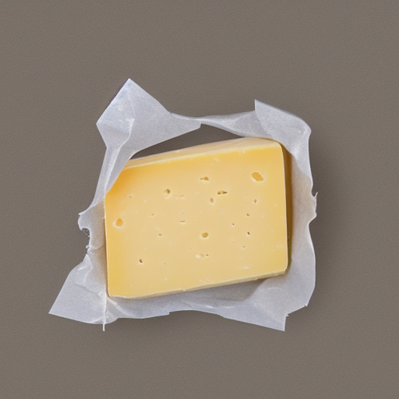

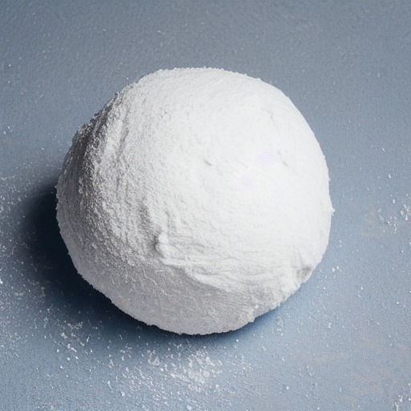
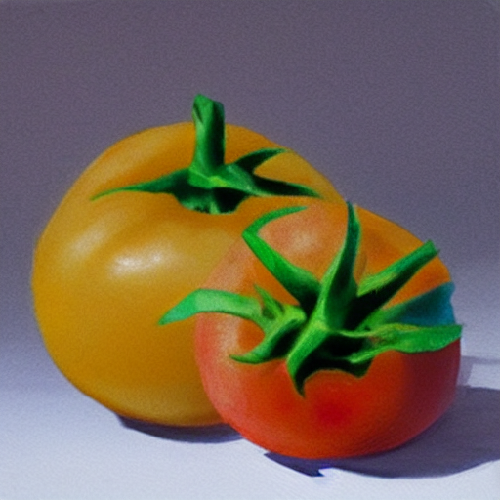
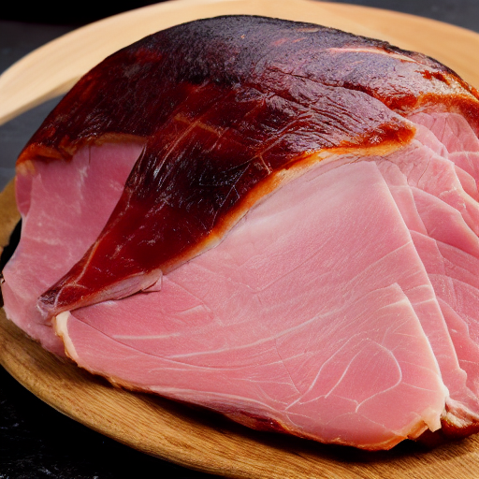
Recipes to fail
Exploration
"Data scientist girl who cook with a suit in a kitchen, artstation concept art"
Project timeline
Le MLOps est une aventure Humaine – Guillaule Chervet
Notes:
So, Elisabeth is an excellent cook, we asked her to knead the pizza dough and spread it. She does it very well.

Slide 26
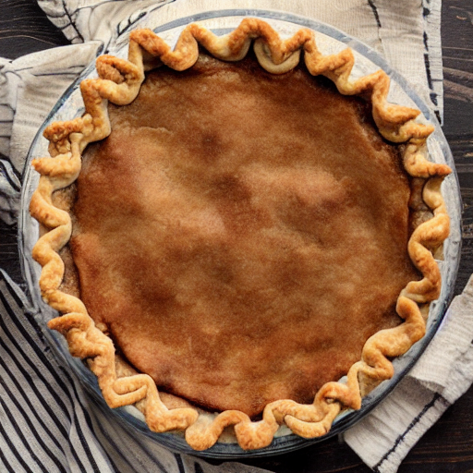
Recipes to fail
Exploration
"Data scientist girl who cook with a suit in a kitchen, artstation concept art"
Project timeline
Le MLOps est une aventure Humaine – Guillaume Chervet
Notes:
Now, Elisabeth is done.

Slide 27

Recipes to fail
Exploration
Industrialization
"Data scientist girl who cook with a suit in a kitchen, artstation concept art"
"Developer waiter in t-shirt in a restaurant , artstation concept art"
Project timeline
Le MLOps est une aventure Humaine – Guillaume Chervet
Notes:
I present you, Hicham, his role is to distribute the ingredients on the pizza dough.

Slide 28
Recipes to fail
Exploration
Industrialization
Hop
"Data scientist girl who cook with a suit in a kitchen, artstation concept art"
"Developer waiter in t-shirt in a restaurant , artstation concept art"
Project timeline
Le MLOps est une aventure Humaine – Devoxx France 2023 – Guillaume Chervet
Notes:
Now Elisabeth, sends the pizza dough and the ingredients to Hicham. As you can see on the left, Elisabeth forgot to give the ham to Hicham.

Slide 29
Recipes to fail
Exploration
Industrialization
"Developer waiter in t-shirt in a restaurant , artstation concept art"
Project timeline
Le MLOps est une aventure Humaine – Guillaume Chervet
Notes:
So now, Hicham, it's his turn to play and it's up to him to spread the ingredients on the pizza dough. However, he realizes that the ham has been forgotten and he expected that Elisabeth would have pre-cut the ingredients. Unfortunately, he does not have any knife.
Hicham as a good developer does everything he can. He takes the ingredients and spreads them as he can on the pizza.

Slide 30
Recipes to fail
Exploration
Industrialization
Deployment & run
"Developer waiter in t-shirt in a restaurant , artstation concept art"
Project timeline
Le MLOps est une aventure Humaine – Guillaume Chervet
Notes:
Good job for Hicham.

Slide 31
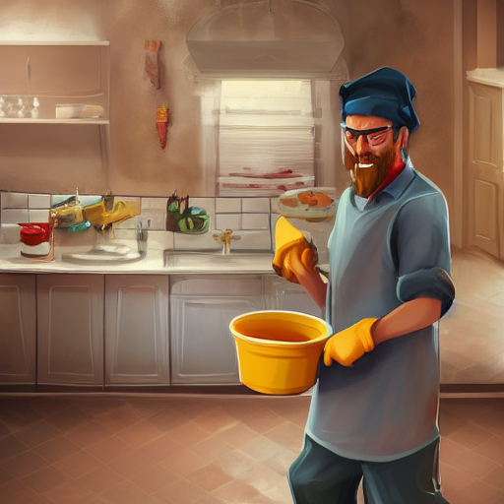
Recipes to fail
Exploration
Industrialization
Deployment & run
"Developer waiter in t-shirt in a restaurant , artstation concept art"
"Man who washes dishes in a kitchen, artstation concept art"
Project timeline
Le MLOps est une aventure Humaine – Guillaume Chervet
Notes:
Now, I present you Khalid; it's our Ops. He is responsible for baking the pizza then to deliver it to the customers.

Slide 32
Recipes to fail
Exploration
Industrialization
Deployment & run
Hop
"Developer waiter in t-shirt in a restaurant , artstation concept art"
"Man who washes dishes in a kitchen, artstation concept art"
Project timeline
Le MLOps est une aventure Humaine - 1er Décembre 2022
Notes:
Hop, Hicham give the pizza to Khalid.

Slide 33
Recipes to fail
Exploration
Industrialization
Deployment & run
"Man who washes dishes in a kitchen, artstation concept art"
Project timeline
Le MLOps est une aventure Humaine – Guillaume Chervet
Notes:
Damn, we forgot to give the instructions to Khalid. He doesn't know how to cook it (what temperature, and for how long). So, Khalid try to cook the pizza as he can.

Slide 34
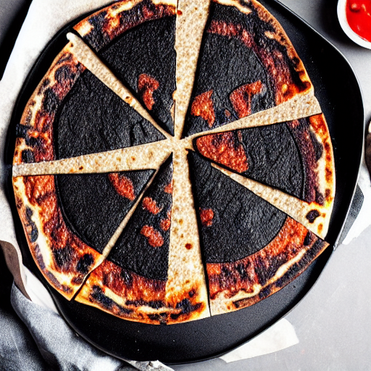
Recipes to fail
Exploration
Industrialization
Deployment & run
"Man who washes dishes in a kitchen, artstation concept art"
Project timeline
Le MLOps est une aventure Humaine – Guillaume Chervet
Notes:
Unfortunately, now the pizza – without ham, and with badmy cut ingredients – is burnt. Good luck eating that!

Slide 35
Recipes to fail
Exploration
Industrialization
Deployment & run
Organize your teams to work in silo !
"Data scientist girl who cook with a suit in a kitchen, artstation concept art"
"Developer waiter in t-shirt in a restaurant , artstation concept art"
"Man who washes dishes in a kitchen, artstation concept art"
Project timeline
Le MLOps est une aventure Humaine – Guillaume Chervet
Notes:
To sum up, here we have organized our team in silo, each role working separately, and also at the same time. It’s not a team mode. If you want to wreck your project, this is the right way to organize.
You should know that the very first choice of libraries from the start of the project has a direct impact on production. Not working together, not worrying about production from the beginning of the project, are silver bullets to make project fail.

Slide 36
People
Cross functional teams
Master
ML Ops
Collaboration
Tech
&
Data
Process
Automation
Le MLOps est une aventure Humaine – Guillaume Chervet

Slide 37


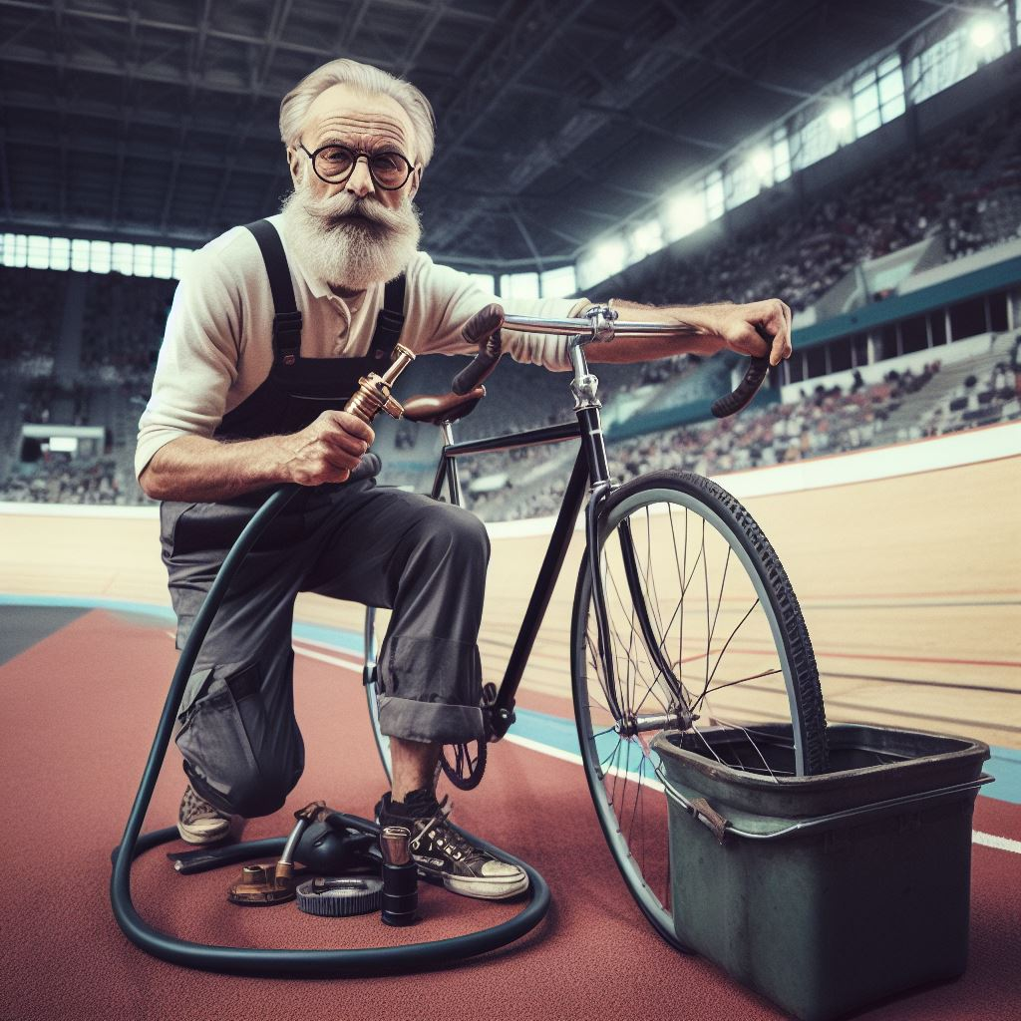
Le MLOps est une aventure Humaine – Guillaume Chervet
Le MLOps est une aventure Humaine – Guillaume Chervet
Notes:
The most important thing in a project is to meet user’s needs.
User wants a good prediction quality,
User wants the cheapest project as possible,
User doesn’t want to wait for a result. At AXA France we must answer a prediction in less than 10 seconds for our use-cases.
Safety is non-negotiable.
We want the projects to be monitored. The idea is that if DATA DRIFT starts, this risk causing a production incident. If we are on a major project that can block AXA France, we are not going to wait for the incident to come.
So, the last point, we must be able to re-train and redeploy quickly. If we have a major incident that blocks AXA France, we must be able to re-deploy as quickly as possible and not wait months to unblock the situation.

Slide 38
Recipes for success
1) Breaking down team silos
Le MLOps est une aventure Humaine – Guillaume Chervet
Notes:
The most important thing in a project is to meet user’s needs.
User wants a good prediction quality,
User wants the cheapest project as possible,
User doesn’t want to wait for a result. At AXA France we must answer a prediction in less than 10 seconds for our use-cases.
Safety is non-negotiable.
We want the projects to be monitored. The idea is that if DATA DRIFT starts, this risk causing a production incident. If we are on a major project that can block AXA France, we are not going to wait for the incident to come.
So, the last point, we must be able to re-train and redeploy quickly. If we have a major incident that blocks AXA France, we must be able to re-deploy as quickly as possible and not wait months to unblock the situation.

Slide 39
Recipes for success
Share same objectives
1) Breaking down team silos
Le MLOps est une aventure Humaine – Guillaume Chervet
Notes:
The most important thing in a project is to meet user’s needs.
User wants a good prediction quality,
User wants the cheapest project as possible,
User doesn’t want to wait for a result. At AXA France we must answer a prediction in less than 10 seconds for our use-cases.
Safety is non-negotiable.
We want the projects to be monitored. The idea is that if DATA DRIFT starts, this risk causing a production incident. If we are on a major project that can block AXA France, we are not going to wait for the incident to come.
So, the last point, we must be able to re-train and redeploy quickly. If we have a major incident that blocks AXA France, we must be able to re-deploy as quickly as possible and not wait months to unblock the situation.

Slide 40
Recipes for success
Share same objectives
Use Agile methods
1) Breaking down team silos
Le MLOps est une aventure Humaine – Guillaume Chervet
Notes:
The most important thing in a project is to meet user’s needs.
User wants a good prediction quality,
User wants the cheapest project as possible,
User doesn’t want to wait for a result. At AXA France we must answer a prediction in less than 10 seconds for our use-cases.
Safety is non-negotiable.
We want the projects to be monitored. The idea is that if DATA DRIFT starts, this risk causing a production incident. If we are on a major project that can block AXA France, we are not going to wait for the incident to come.
So, the last point, we must be able to re-train and redeploy quickly. If we have a major incident that blocks AXA France, we must be able to re-deploy as quickly as possible and not wait months to unblock the situation.

Slide 41
Recipes for success
Share same objectives
Use Agile methods
Use a monorepository GIT
1) Breaking down team silos
Le MLOps est une aventure Humaine – Guillaume Chervet
Notes:
The most important thing in a project is to meet user’s needs.
User wants a good prediction quality,
User wants the cheapest project as possible,
User doesn’t want to wait for a result. At AXA France we must answer a prediction in less than 10 seconds for our use-cases.
Safety is non-negotiable.
We want the projects to be monitored. The idea is that if DATA DRIFT starts, this risk causing a production incident. If we are on a major project that can block AXA France, we are not going to wait for the incident to come.
So, the last point, we must be able to re-train and redeploy quickly. If we have a major incident that blocks AXA France, we must be able to re-deploy as quickly as possible and not wait months to unblock the situation.

Slide 42

Recipes for success
2) Do not forget that data is gold
Le MLOps est une aventure Humaine – Guillaume Chervet
Notes:
The most important thing in a project is to meet user’s needs.
User wants a good prediction quality,
User wants the cheapest project as possible,
User doesn’t want to wait for a result. At AXA France we must answer a prediction in less than 10 seconds for our use-cases.
Safety is non-negotiable.
We want the projects to be monitored. The idea is that if DATA DRIFT starts, this risk causing a production incident. If we are on a major project that can block AXA France, we are not going to wait for the incident to come.
So, the last point, we must be able to re-train and redeploy quickly. If we have a major incident that blocks AXA France, we must be able to re-deploy as quickly as possible and not wait months to unblock the situation.

Slide 43
Industrialize labelling
Recipes for success
2) Do not forget that data is gold
Le MLOps est une aventure Humaine – Guillaume Chervet
Notes:
The most important thing in a project is to meet user’s needs.
User wants a good prediction quality,
User wants the cheapest project as possible,
User doesn’t want to wait for a result. At AXA France we must answer a prediction in less than 10 seconds for our use-cases.
Safety is non-negotiable.
We want the projects to be monitored. The idea is that if DATA DRIFT starts, this risk causing a production incident. If we are on a major project that can block AXA France, we are not going to wait for the incident to come.
So, the last point, we must be able to re-train and redeploy quickly. If we have a major incident that blocks AXA France, we must be able to re-deploy as quickly as possible and not wait months to unblock the situation.

Slide 44
Industrialize labelling
Setup feedback loop
Recipes for success
2) Do not forget that data is gold
Le MLOps est une aventure Humaine – Guillaume Chervet
Notes:
The most important thing in a project is to meet user’s needs.
User wants a good prediction quality,
User wants the cheapest project as possible,
User doesn’t want to wait for a result. At AXA France we must answer a prediction in less than 10 seconds for our use-cases.
Safety is non-negotiable.
We want the projects to be monitored. The idea is that if DATA DRIFT starts, this risk causing a production incident. If we are on a major project that can block AXA France, we are not going to wait for the incident to come.
So, the last point, we must be able to re-train and redeploy quickly. If we have a major incident that blocks AXA France, we must be able to re-deploy as quickly as possible and not wait months to unblock the situation.

Slide 45
Industrialize labelling
Setup feedback loop
Find labelling tool
Recipes for success
2) Do not forget that data is gold
Le MLOps est une aventure Humaine – Guillaume Chervet
Notes:
The most important thing in a project is to meet user’s needs.
User wants a good prediction quality,
User wants the cheapest project as possible,
User doesn’t want to wait for a result. At AXA France we must answer a prediction in less than 10 seconds for our use-cases.
Safety is non-negotiable.
We want the projects to be monitored. The idea is that if DATA DRIFT starts, this risk causing a production incident. If we are on a major project that can block AXA France, we are not going to wait for the incident to come.
So, the last point, we must be able to re-train and redeploy quickly. If we have a major incident that blocks AXA France, we must be able to re-deploy as quickly as possible and not wait months to unblock the situation.

Slide 46
Industrialize labelling
Setup feedback loop
Find labelling tool
Visualize data
Recipes for success
2) Do not forget that data is gold
Le MLOps est une aventure Humaine – Guillaume Chervet
Notes:
The most important thing in a project is to meet user’s needs.
User wants a good prediction quality,
User wants the cheapest project as possible,
User doesn’t want to wait for a result. At AXA France we must answer a prediction in less than 10 seconds for our use-cases.
Safety is non-negotiable.
We want the projects to be monitored. The idea is that if DATA DRIFT starts, this risk causing a production incident. If we are on a major project that can block AXA France, we are not going to wait for the incident to come.
So, the last point, we must be able to re-train and redeploy quickly. If we have a major incident that blocks AXA France, we must be able to re-deploy as quickly as possible and not wait months to unblock the situation.

Slide 47

Recipes for success
3) Focus on Users needs
Le MLOps est une aventure Humaine – Guillaume Chervet
Notes:
The most important thing in a project is to meet user’s needs.
User wants a good prediction quality,
User wants the cheapest project as possible,
User doesn’t want to wait for a result. At AXA France we must answer a prediction in less than 10 seconds for our use-cases.
Safety is non-negotiable.
We want the projects to be monitored. The idea is that if DATA DRIFT starts, this risk causing a production incident. If we are on a major project that can block AXA France, we are not going to wait for the incident to come.
So, the last point, we must be able to re-train and redeploy quickly. If we have a major incident that blocks AXA France, we must be able to re-deploy as quickly as possible and not wait months to unblock the situation.

Slide 48

Recipes for success
4) Understand that it’s 100% Software development
"un ordinateur"
Le MLOps est une aventure Humaine – Guillaume Chervet
Notes:
The most important thing in a project is to meet user’s needs.
User wants a good prediction quality,
User wants the cheapest project as possible,
User doesn’t want to wait for a result. At AXA France we must answer a prediction in less than 10 seconds for our use-cases.
Safety is non-negotiable.
We want the projects to be monitored. The idea is that if DATA DRIFT starts, this risk causing a production incident. If we are on a major project that can block AXA France, we are not going to wait for the incident to come.
So, the last point, we must be able to re-train and redeploy quickly. If we have a major incident that blocks AXA France, we must be able to re-deploy as quickly as possible and not wait months to unblock the situation.

Slide 49
Recipes for success
4) Understand that it’s 100% Software development
"un ordinateur"
Use Dev, Ops Data best practices
Le MLOps est une aventure Humaine – Guillaume Chervet
Notes:
The most important thing in a project is to meet user’s needs.
User wants a good prediction quality,
User wants the cheapest project as possible,
User doesn’t want to wait for a result. At AXA France we must answer a prediction in less than 10 seconds for our use-cases.
Safety is non-negotiable.
We want the projects to be monitored. The idea is that if DATA DRIFT starts, this risk causing a production incident. If we are on a major project that can block AXA France, we are not going to wait for the incident to come.
So, the last point, we must be able to re-train and redeploy quickly. If we have a major incident that blocks AXA France, we must be able to re-deploy as quickly as possible and not wait months to unblock the situation.

Slide 50
Recipes for success
4) Understand that it’s 100% Software development
"un ordinateur"
Use Dev, Ops Data best practices
Build a platform where everyone can work together
Le MLOps est une aventure Humaine – Guillaume Chervet
Notes:
The most important thing in a project is to meet user’s needs.
User wants a good prediction quality,
User wants the cheapest project as possible,
User doesn’t want to wait for a result. At AXA France we must answer a prediction in less than 10 seconds for our use-cases.
Safety is non-negotiable.
We want the projects to be monitored. The idea is that if DATA DRIFT starts, this risk causing a production incident. If we are on a major project that can block AXA France, we are not going to wait for the incident to come.
So, the last point, we must be able to re-train and redeploy quickly. If we have a major incident that blocks AXA France, we must be able to re-deploy as quickly as possible and not wait months to unblock the situation.

Slide 51

Logs
Infrastructure
Business
Drift
Cost
Recipes for success
5) Setup Monitoring
Le MLOps est une aventure Humaine – Guillaume Chervet
Notes:
The most important thing in a project is to meet user’s needs.
User wants a good prediction quality,
User wants the cheapest project as possible,
User doesn’t want to wait for a result. At AXA France we must answer a prediction in less than 10 seconds for our use-cases.
Safety is non-negotiable.
We want the projects to be monitored. The idea is that if DATA DRIFT starts, this risk causing a production incident. If we are on a major project that can block AXA France, we are not going to wait for the incident to come.
So, the last point, we must be able to re-train and redeploy quickly. If we have a major incident that blocks AXA France, we must be able to re-deploy as quickly as possible and not wait months to unblock the situation.

Slide 52

Recipes for success
Dailyclean
Ecotag
SlimFaaS
SlightCapture
6) Open your mindeset
Le MLOps est une aventure Humaine– Guillaume Chervet
Notes:
MLOPS is not centered on tools, however thanks to our projects, we have been able to set up tools and open source them. It is a pleasure to share them with you.
The daily clean allows us to automatically shut down Kubernetes environment.
Ecotag allows us to make labelling and comply with GDPR rules.
ml-cli is our integration test tool.

Slide 53
Le mlops traite également les défis suivants
Explicabilité et transparence
Robustesse
IA Responsable

Slide 54
Le projet de cette année
Un Chatbot qui prédit les survivants du titanic

Slide 55
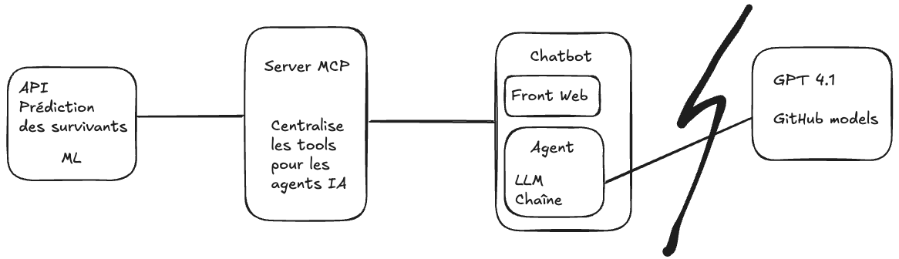
Présentation du projet en production

Slide 56
Démo ?

Slide 57

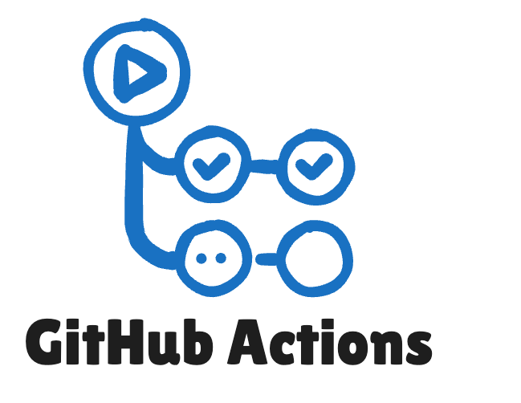




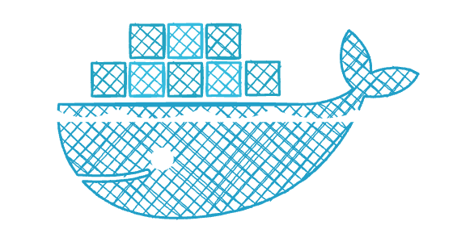


Nos outils
Your Github account where your code repository will belong
Feature from Github to create « CI/CD pipelines »
AWS S3 like. Where you will store your data and where mlFlow will store your artifacts
ML Swiss Knife. We will use it to track our experiments, store our ML artifacts and to run experiments with
its Command-Line Interface (CLI) from our Github Actions
Database used by mlFlow
Container registry. Free for open source purposes to any RedHat developers accounts. We will store our Docker
Images here
Allows to create our training environments and webservice artifacts as containers
Enterprise platform built on Kubernetes. Simplifies deploying, managing, and securing containerized apps (as
mlFlow or our MLWebservice ;))
Free, cloud-based development environment that runs on a Red Hat OpenShift sandbox, allowing you
to develop and test applications without local setup

Slide 58
Big picture

Slide 59
!!! Warning !!!
VOTRE SANDBOX SE DÉTRUIT SOUS 30 JOURS
COMMITEZ ET PUSHEZ RÉGULIÈREMENT

Slide 60
!!! Warning !!!
DO NOT USE THIS SANDBOX ENVIRONMENT FOR ANY OF
YOUR PROFESSIONAL PROJECTS
DO NOT USE REAL DATA FROM YOUR COMPAGNY

Slide 61
Lets’ goooooo!!!!!!
https://github.com/guillaume-thomas/kto-api-and-cloud

